Slide 1
Rockbuster Stealth Data Analysis
Kyle Irish
Tableau Visualizations:
https://public.tableau.com/views/K_Irish3_10PresentingSQLResults/CustomersbyCountry?:language=en-US&publish=yes&:display_count=n&:origin=viz_share_link

Slide 2
Objective and Key Questions
Analysis of Rockbuster Stealth movie rental data loaded into a database. Purpose is to assist the business transition to an online model by answering:
Rental Questions:
What was the average rental duration for all videos?
Which movies contributed the most/least to revenue gain?
Are any categories of movies more valuable?
Location Questions:
Which countries are Rockbuster customers based in?
Where are customers with a high lifetime value based?
Do sales figures vary between geographic regions?

Slide 3
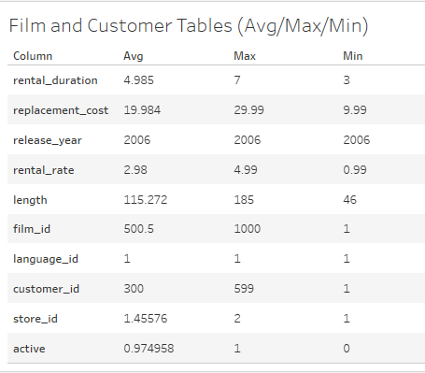
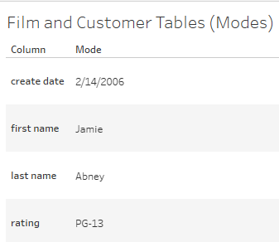
Rental Questions : Film and Customer Overview
The average rental duration is 5 days
The most common film rating is PG-13

Slide 4
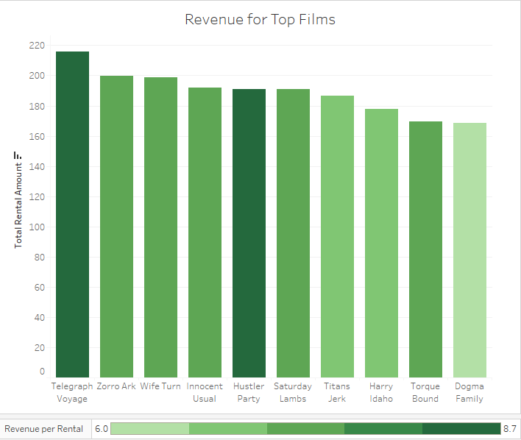
Rental Questions : High Revenue Films
Top 10 films total revenue between $168 and $216
Revenue per rental ratio between 6 and 8.7
Average for all films is 4.2
Telegraph Voyage and Hustler Party have highest revenue per rental ratio

Slide 5
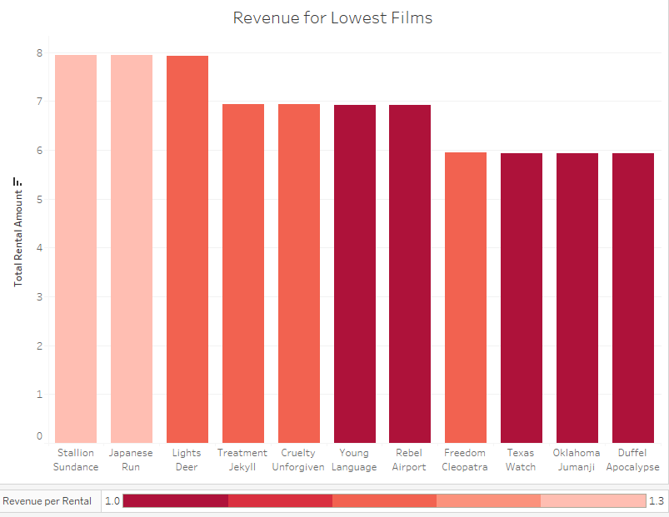
Rental Questions : Lowest Revenue Films
Bottom 11 films total revenue between $5 and $8
Top 2 tied at $7.94
Revenue per rental ratio between 1 and 1.3
Average for all films is 4.2

Slide 6
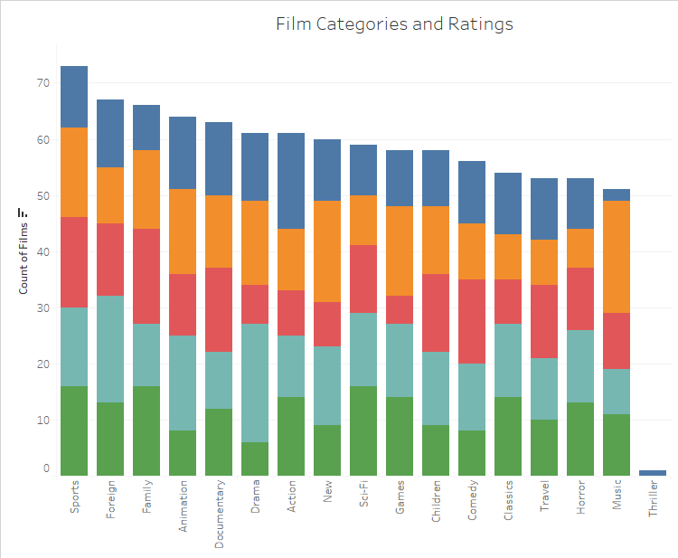

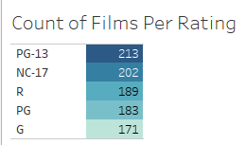
Rental Questions : Categories and Ratings
We have the most Sports movies out of all categories
Range of counts across all categories fairly even at 51 to 73
Excluding the single Thriller film

Slide 7
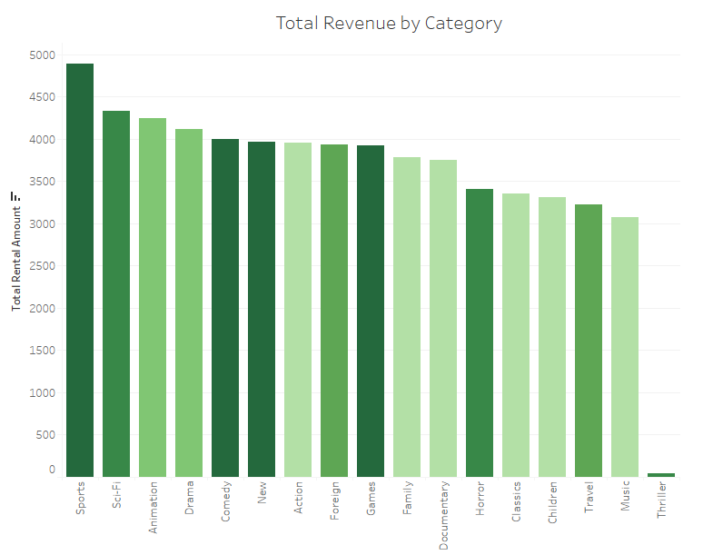

Rental Questions : Revenue by Category
Sports is the highest total revenue category
Sports, Games, and Comedy tied for highest revenue per rental at 4.6
Music lowest total revenue and 2nd lowest revenue per rental
Excluding Thriller

Slide 8
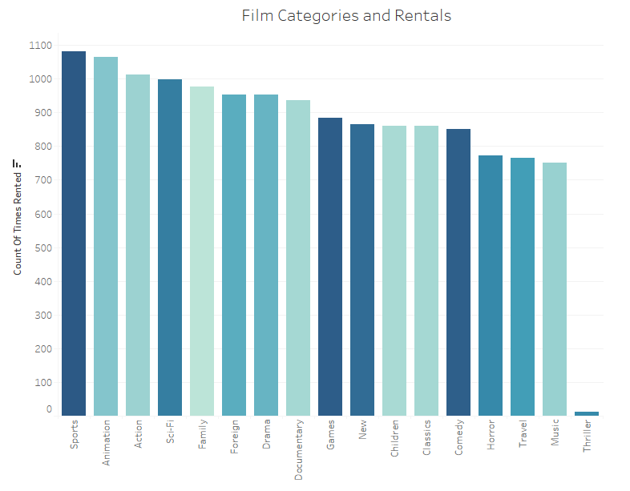

Rental Questions : Rentals by Category
Sports is the most often rented category
Animation and Action have high demand for their low revenue per rental
Music lowest in demand
Excluding Thriller

Slide 9
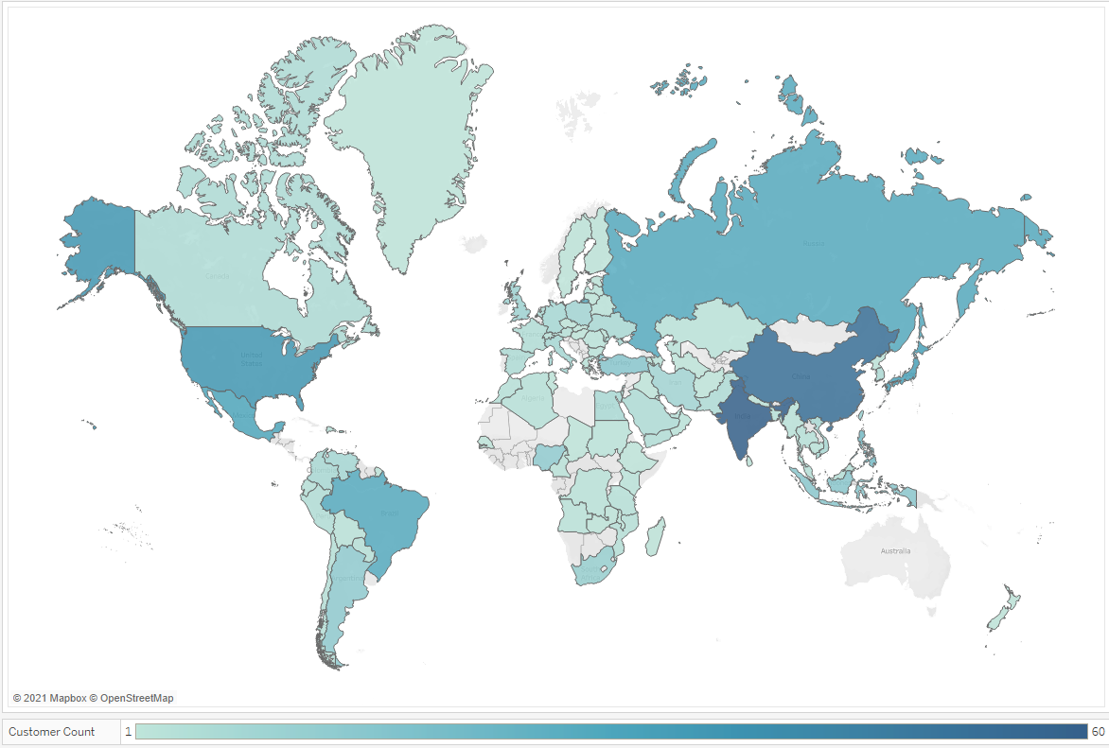
Location Questions : Where are Customers?
Top 5 Countries by Customer Count
India (60)
China (53)
United States (36)
Japan (31)
Mexico (30)
Top Cities: No city holds more than 1 customer.

Slide 10
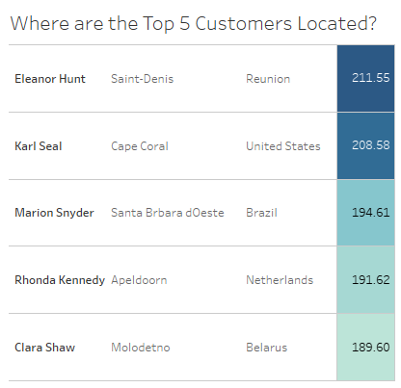
Location Questions : Best Customers?
Average total payment for all customers is $102.4
Of the top 50 highest overall paying customers:
India contains 5
Brazil, Philippines, and China contain 3 each
United States, Iran, Russian Federation, Taiwan, and Thailand have 2 each
The other 26 countries only have 1 each

Slide 11
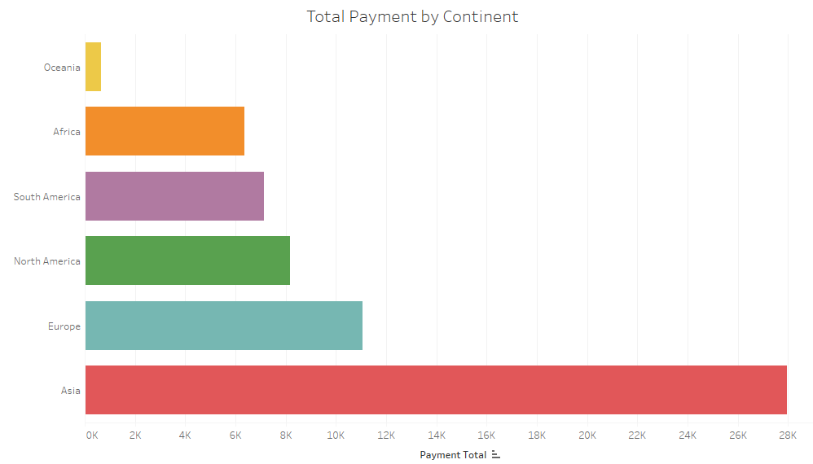
Location Questions : Regional Differences?
Asia by far highest revenue continent
Even with Russia counted in Europe
Asia total = $27,956
All other continents combined = $33,356

Slide 12
Recommendations
Stay with Sports. Sports is highest total revenue category, revenue per rental category, and most rented category.
Stop the Music. While it is the lowest inventory amount of all categories, Music is the least revenue generating and lowest rented category (excluding Thriller).
India should be a focus. It has the highest amount of customers and the most (5) of the top 50 highest paying customers. It is also centered in the highest revenue generating continent of Asia.
Rental rate can be adjusted based on a combination of rental amount, revenue, and revenue per rental.
For example Action movies may be priced too low. The demand is high as the 3rd most rented category. But the category is in the middle of total revenue and tied for the 2nd lowest average revenue per rental across categories.

